Slide 1
Design, Development, and Evaluation of a Community-Enhanced Library Management System Using Modern Web Technologies
By
Nathaniel Chukwuma Ani

Slide 2
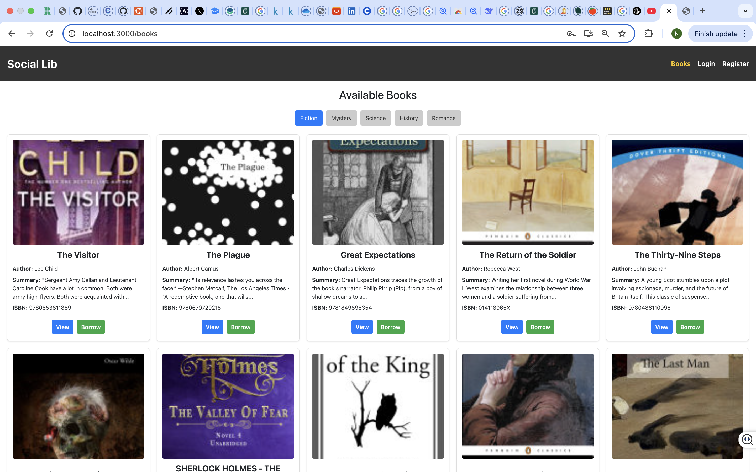
API View upon loading frontend
System starts by checking for user authentication token to determine access level.

Slide 3
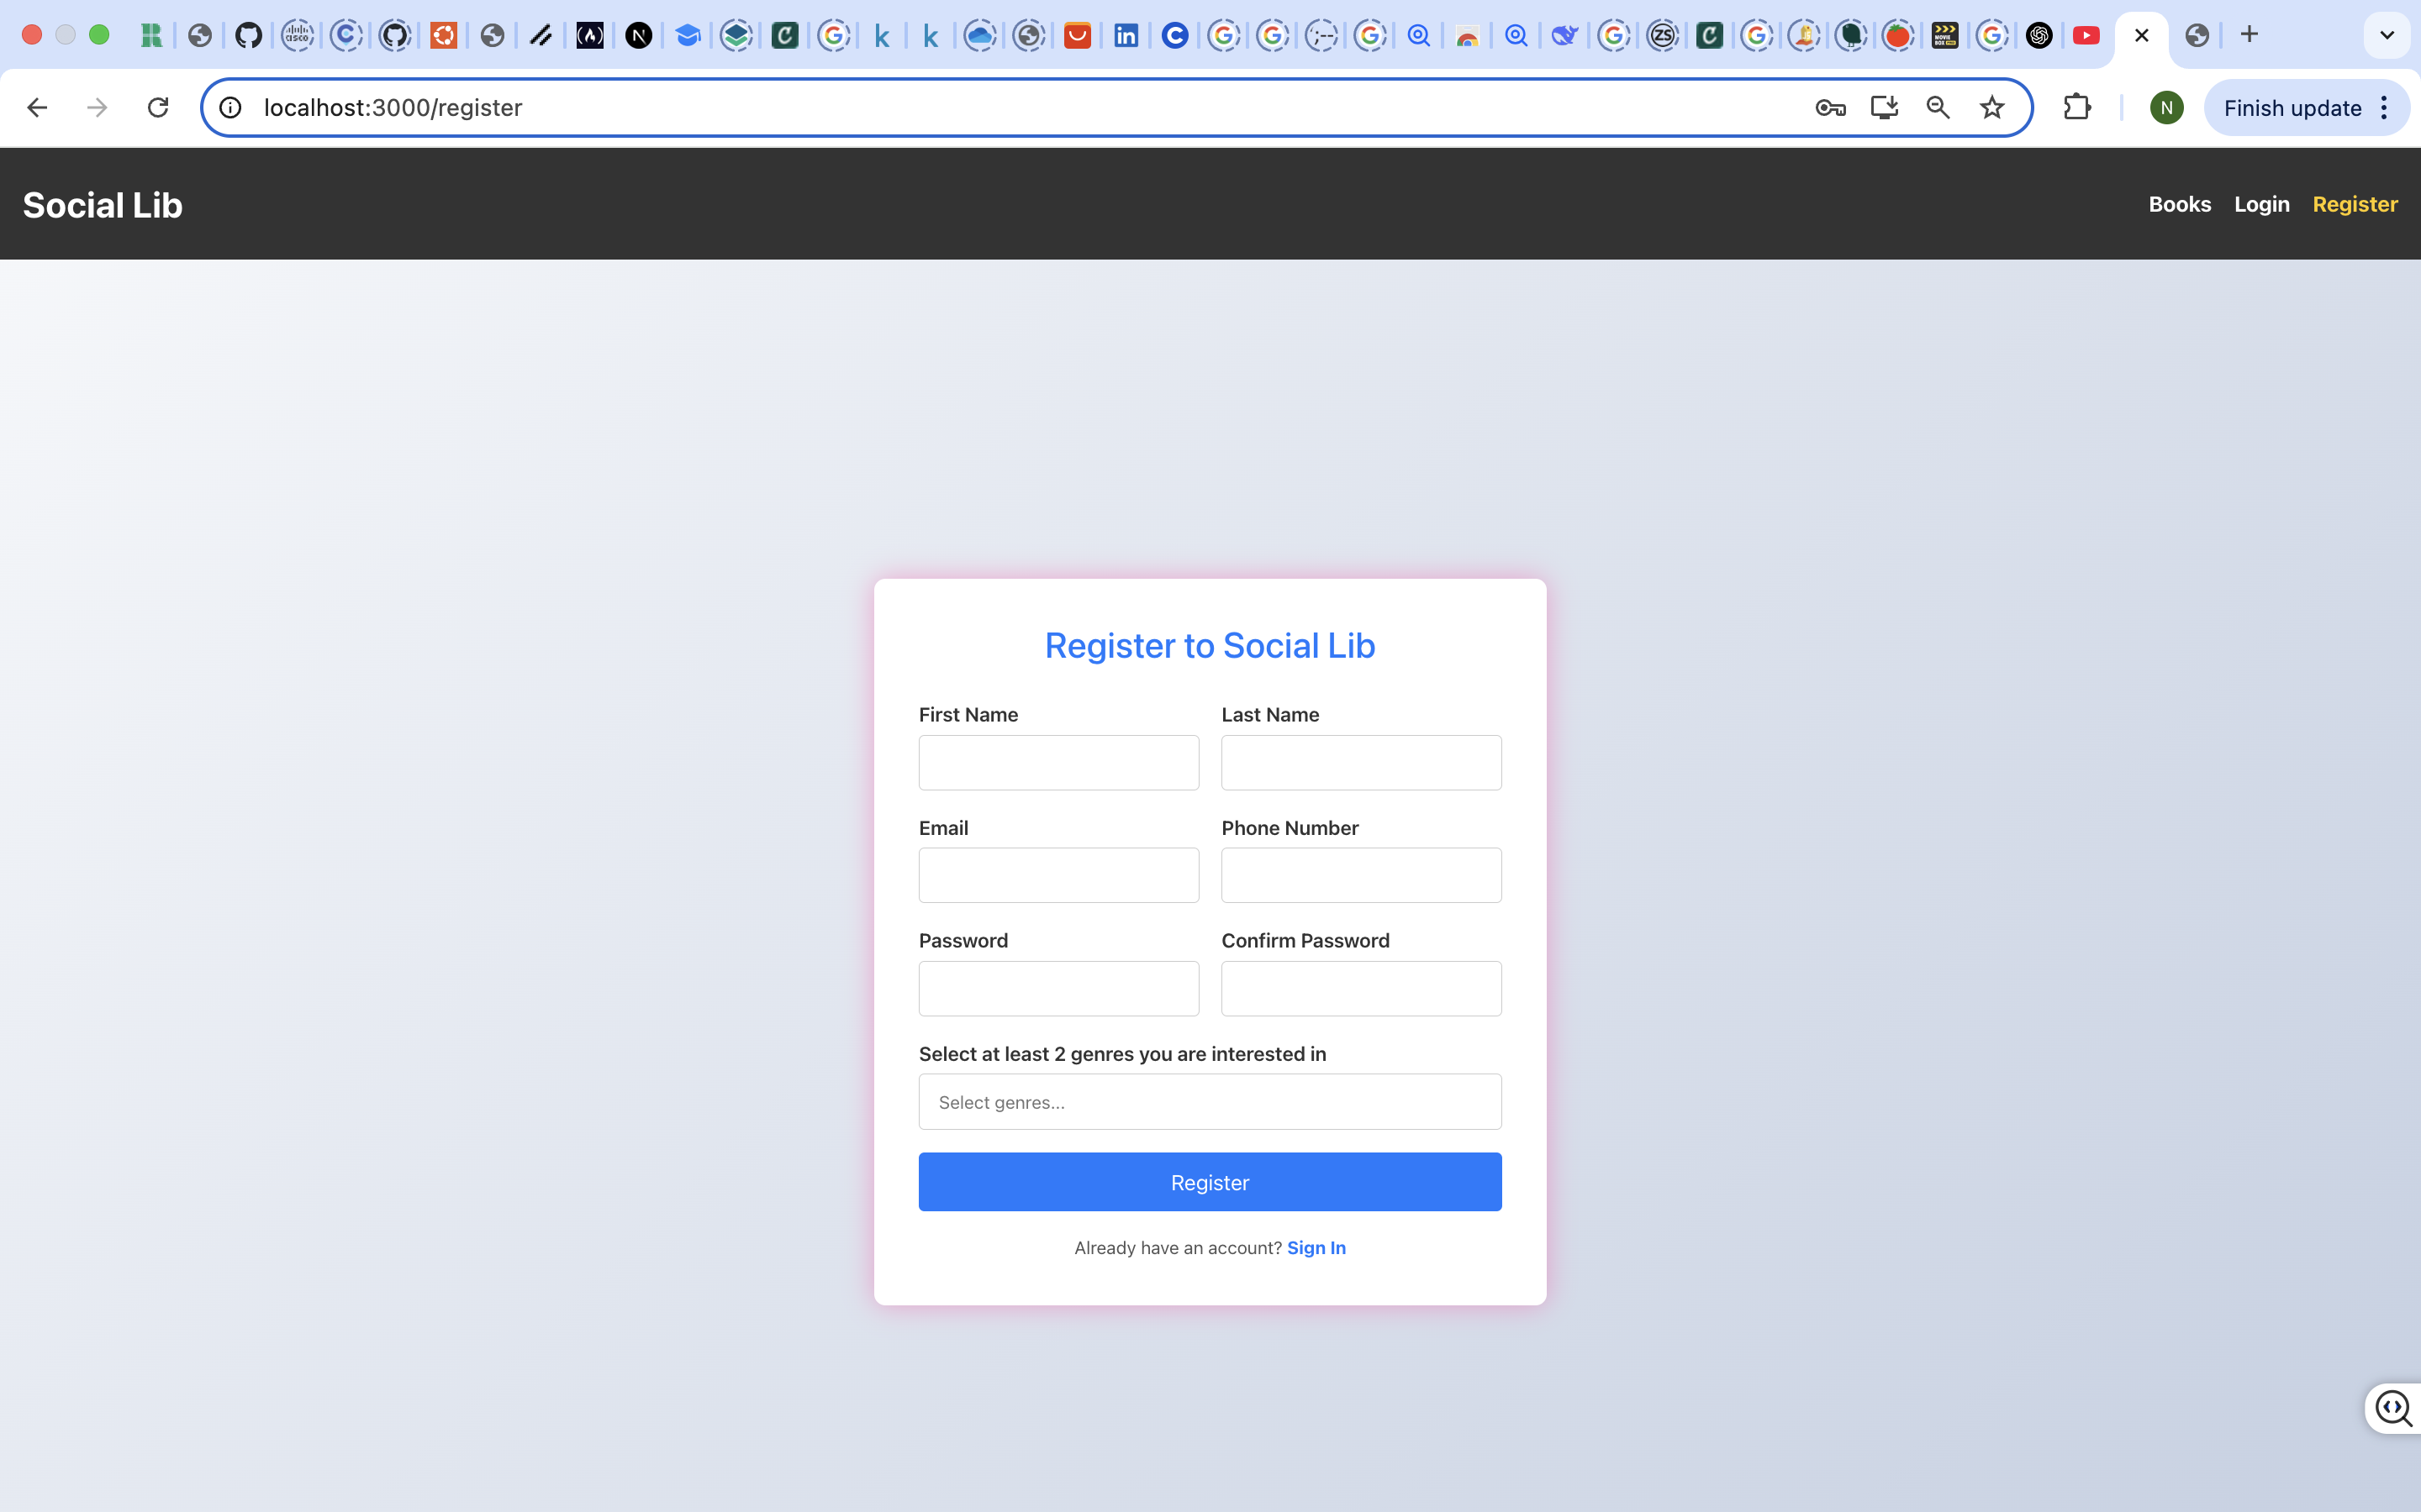
Register page Endpoint
If user doesn’t have an account, they will be prompted to register an account

Slide 4
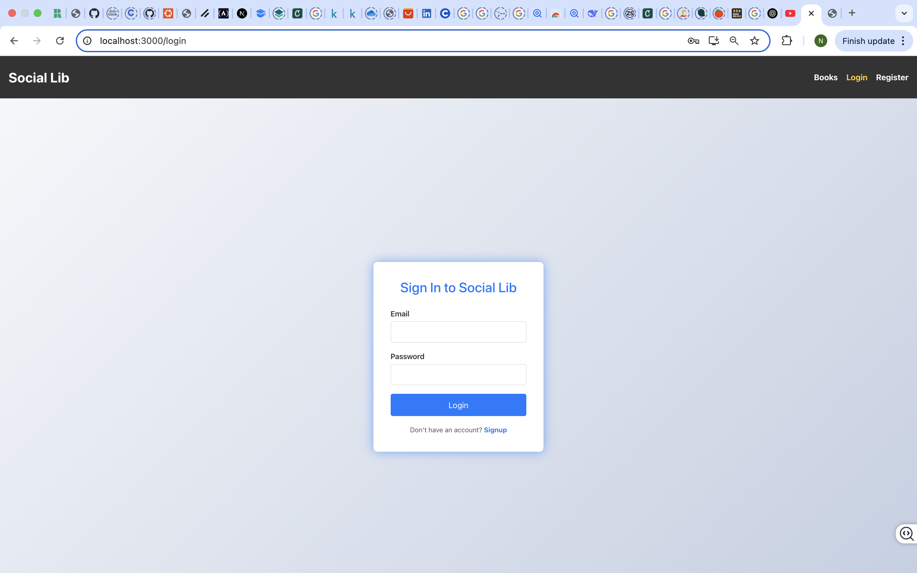
User Login Flow (POST/api/accounts/login/)
User is redirected to log in page

Slide 5
Books Endpoint upon user sign in
Upon successful registration / Log in, user gets to books endpoint

Slide 6
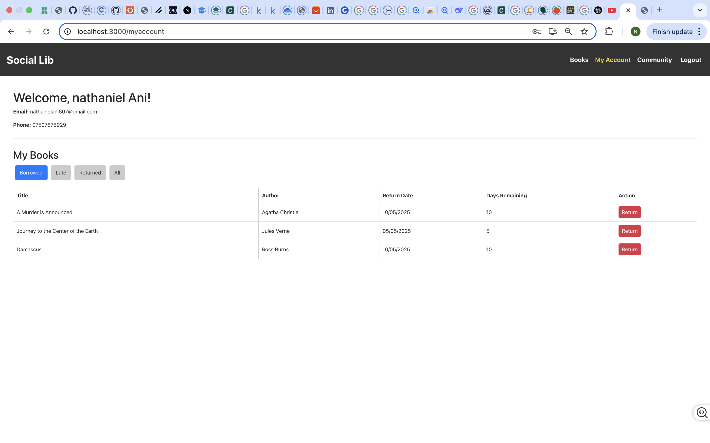
Endpoint showing user account details
User is able to view account information regarding borrowed books

Slide 7
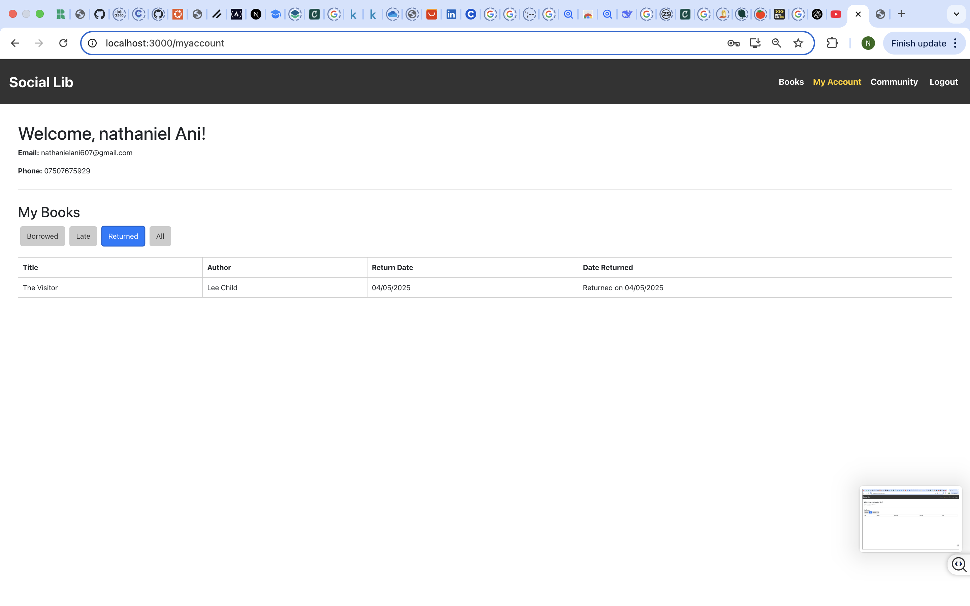
Endpoint showing Returned books
User can also view returned books

Slide 8
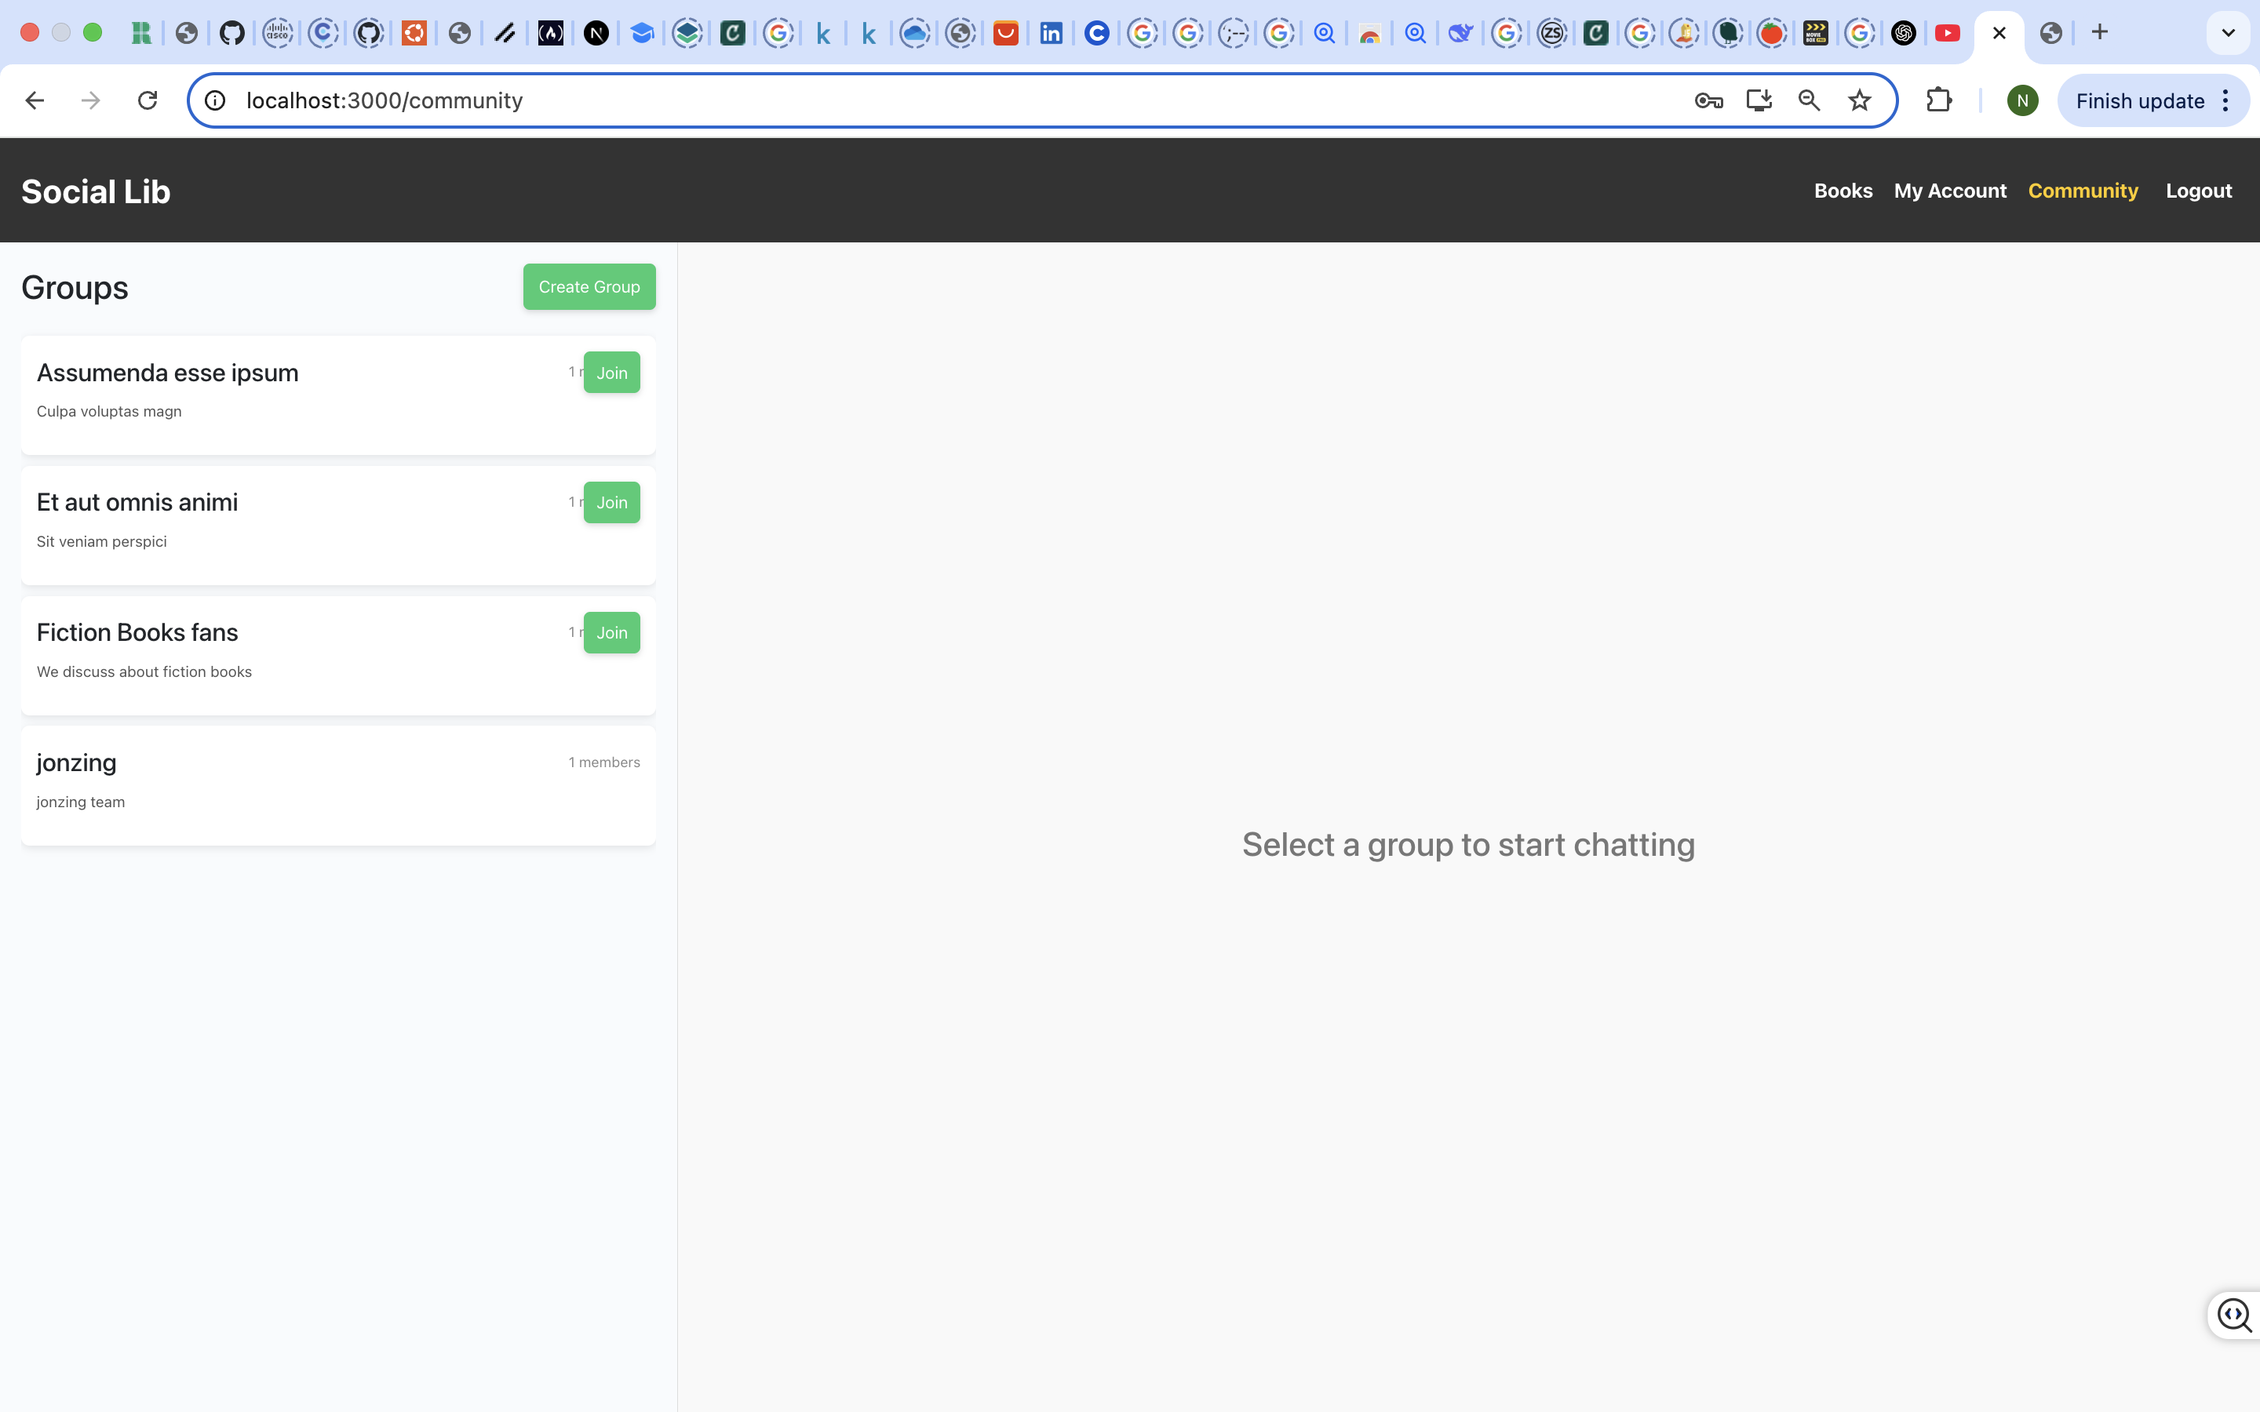
Community Endpoint
User can utilize the integrated Social community Groups

Slide 9
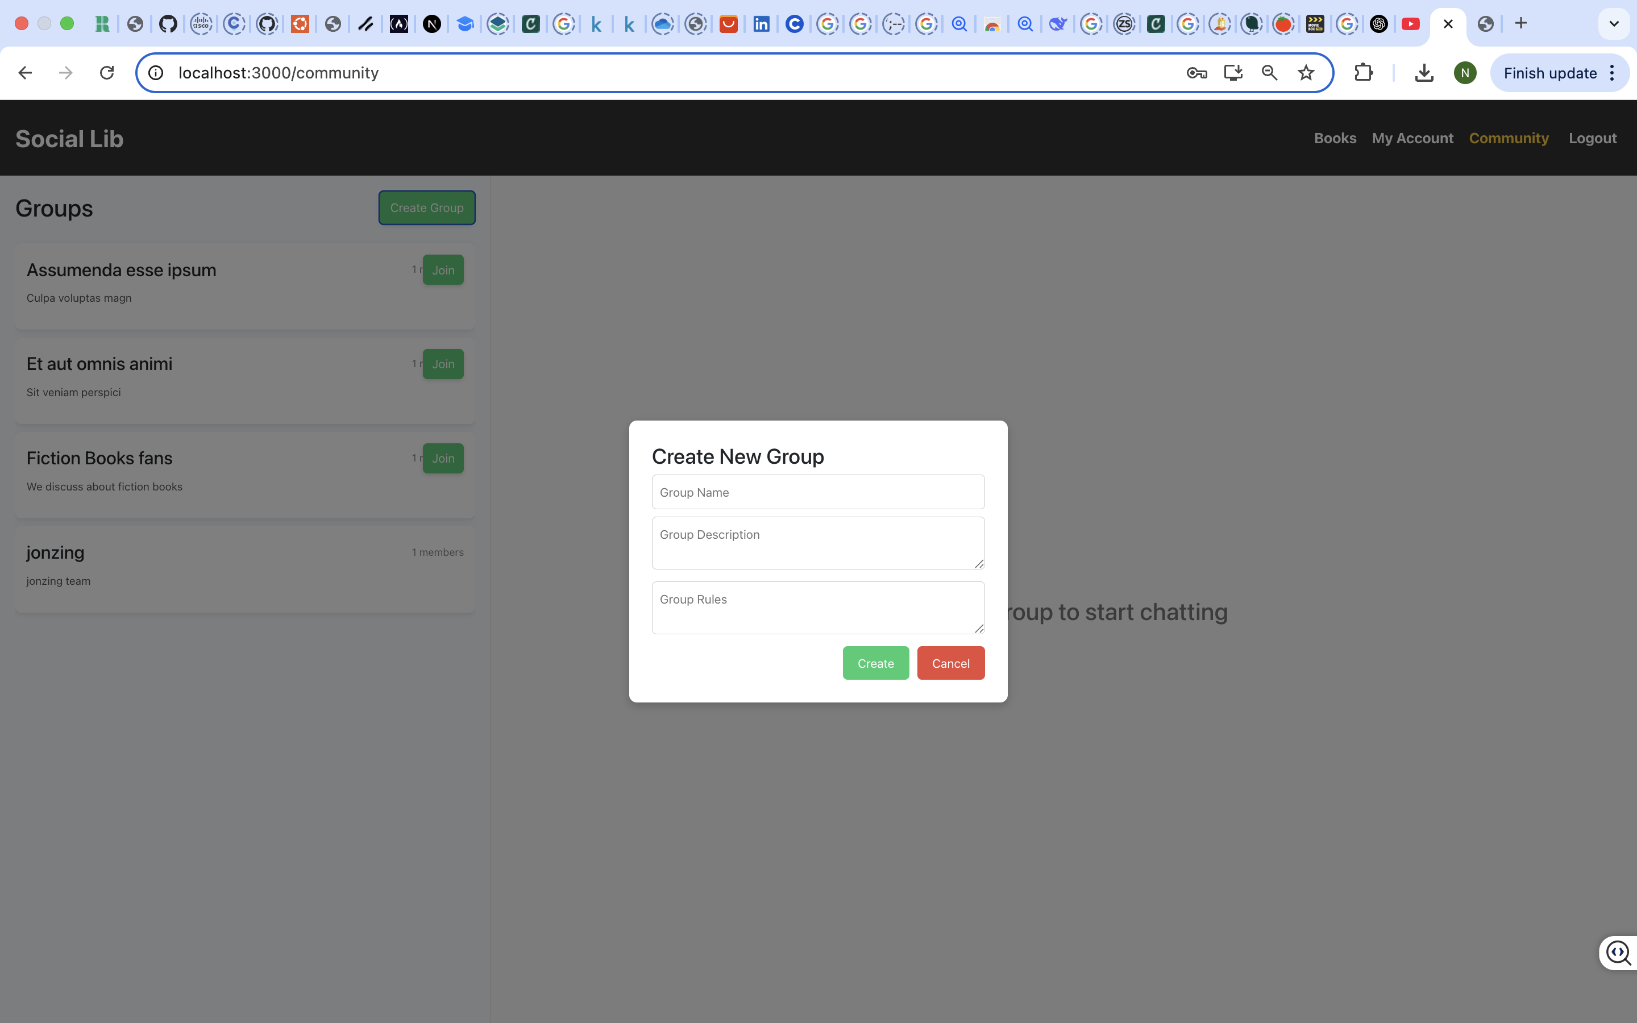
Group List and join flow (GET/POST/api/social/groups)
User has the authorization to create groups and upon creation, made an Admin

Slide 10
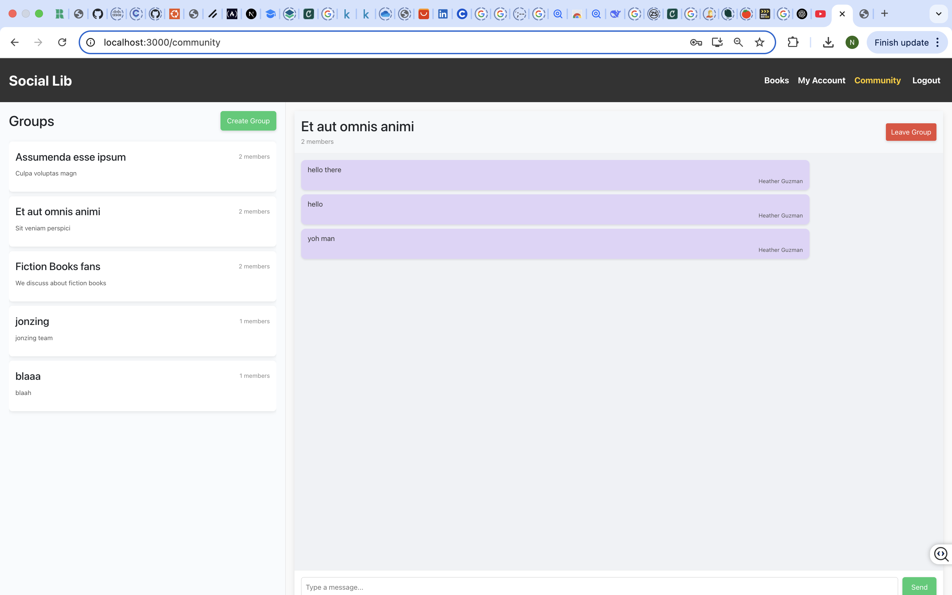
Option to leave Community Group
User is also given option to leave Group chats

Slide 11
Technologies used
Django Rest framework (DRF) – for building robust, modular API
Token Authentication – to secure endpoints with user-specific access token
Postman – used for testing and validating api endpoints
React (Frontend) – for building a user-friendly interface to consume api
SQLite – Lightweight development database for quick iterations

Slide 12
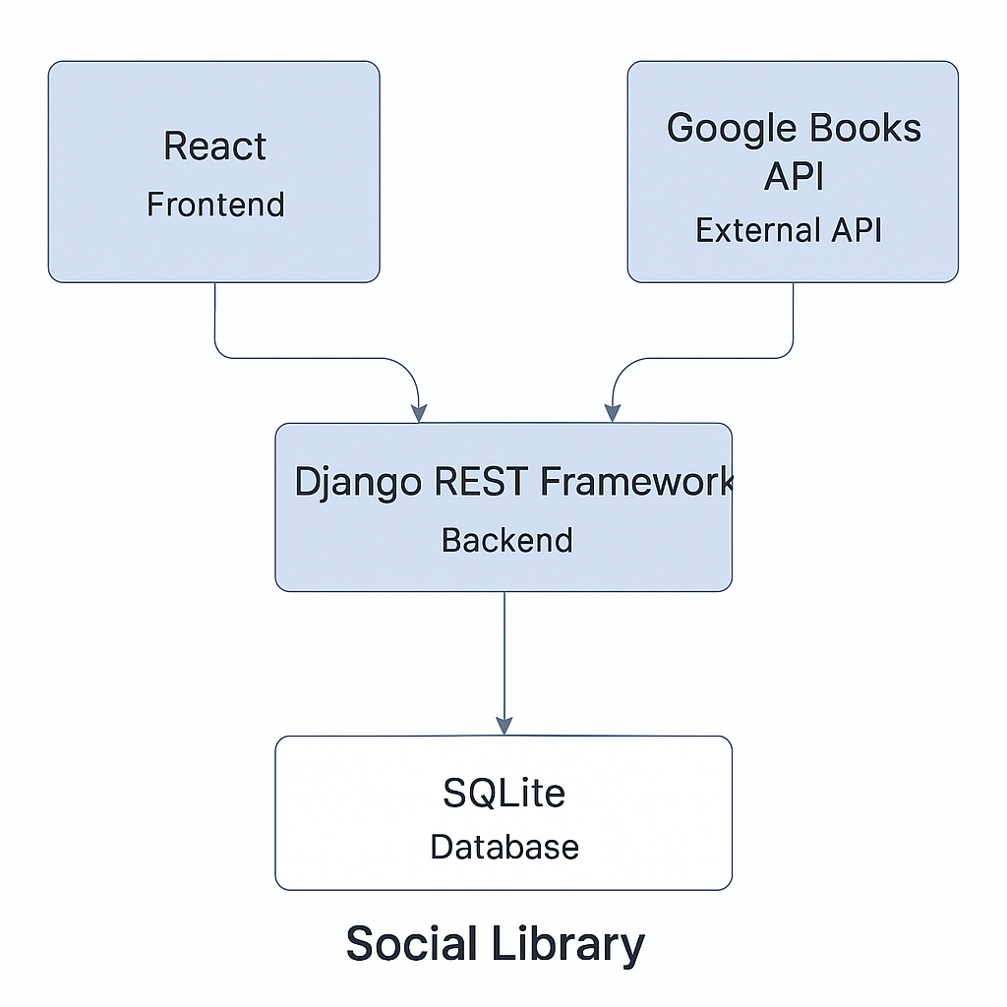
System Architecture Design

Slide 13
Conclusion
Able to achieve user registration and log in with secure token auth.
Implemented Books endpoints for borrowing and returning.
Demonstrated community group features.
Demonstrated working backend with Postman
Future works – Real time messaging, Private Chat and PostgresSQL.

Slide 14

Thank You and Q&A

